Slide 1
CS162 Operating Systems and Systems Programming Lecture 17 Memory 4: Demand Paging Policies
March 16th, 2023
Prof. John Kubiatowicz
http://cs162.eecs.Berkeley.edu

Slide 2
Recall 61C: Average Memory Access Time
Proc
Used to compute access time probabilistically:
AMAT = Hit Rate_{L1} x Hit Time_{L1} + Miss Rate_{L1} x Miss Time_{L1}
Hit Rate_{L1} + Miss Rate_{L1} = 1 Hit Time_{L1} = Time to get value from L1 cache. Miss Time_{L1} = Hit Time_{L1} + Miss Penalty_{L1} Miss Penalty_{L1} = AVG Time to get value from lower level (DRAM)
So, AMAT = Hit Time_{L1} + Miss Rate_{L1} x Miss Penalty_{L1}
What about more levels of hierarchy?
AMAT = Hit Time_{L1} + Miss Rate_{L1} x Miss Penalty_{L1}
Miss Penalty_{L1} = AVG time to get value from lower level (L2) = Hit Time_{L2} + Miss Rate_{L2} x Miss Penalty_{L2} Miss Penalty_{L2} = Average Time to fetch from below L2 (DRAM)
AMAT = Hit Time_{L1} +
Miss Rate_{L1} x (Hit Time_{L2} + Miss Rate_{L2} x Miss Penalty_{L2})
And so on … (can do this recursively for more levels!)
L1 Cache
DRAM
Proc
L1 Cache
L2 Cache
DRAM

Slide 3
Recall: Caching Applied to Address Translation
Virtual
Address
TLB
Physical
Memory
CPU
Physical
Address
Cached?
Yes
No
Save
Result
Translate
(MMU)
Data Read or Write (untranslated)
Question is one of page locality: does it exist?
Instruction accesses spend a lot of time on same page (accesses are sequential)
Stack accesses have definite locality of reference
Data accesses have less page locality, but still some…
Can we have a TLB hierarchy?
Sure: multiple levels at different sizes/speeds

Slide 4
What Actually Happens on a TLB Miss?
Hardware traversed page tables (x86, many others):
On TLB miss, hardware in MMU looks at current page table to fill TLB (may walk multiple levels)
If PTE valid, hardware fills TLB and processor never knows
If PTE marked as invalid, causes Page Fault, after which kernel decides what to do afterwards
Software traversed Page tables (like MIPS):
On TLB miss, processor receives TLB fault
Kernel traverses page table to find PTE
If PTE valid, fills TLB and returns from fault
If PTE marked as invalid, internally calls Page Fault handler
Most chip sets provide hardware traversal
Modern operating systems tend to have more TLB faults since they use translation for many things
Examples:
shared segments
user-level portions of an operating system

Slide 5
Transparent Exceptions: Page fault
User
Faulting
Inst 1
Restart
Inst 1
Faulting
Inst 2
Restart
Inst 2
Page Faults
OS
Copy on Write/ Update PTE
Fetch page/sleep on queue
Later: Update PTE/restart
How to transparently restart faulting instructions?
(Consider load or store that gets Page fault)
Could we just skip faulting instruction?
No: need to perform load or store after reconnecting physical page!
Hardware must help out by saving:
Faulting instruction and partial state
Need to know which instruction caused fault
Is single PC sufficient to identify faulting position????
Processor State: sufficient to restart user thread
Save/restore registers, stack, etc
What if an instruction has side-effects?

Slide 6
Consider weird things that can happen
What if an instruction has side effects?
Options:
Unwind side-effects (easy to restart)
Finish off side-effects (messy!)
Example 1: mov (sp)+,10
What if page fault occurs when writing to stack pointer?
Did sp get incremented before or after the page fault?
Example 2: strcpy (r1), (r2)
Source and destination overlap: can’t unwind in principle!
IBM S/370 and VAX solution: execute twice – once read-only
What about “RISC” processors?
For instance delayed branches?
Example: bne somewhere ld r1,(sp)
Restart after page fault: need two PCs, PC and nPC!
Delayed exceptions:
Example: div r1, r2, r3 ld r1, (sp)
What if takes many cycles to discover divide by zero, but load has already caused page fault?
Notes:
Nachos and other systems: hardware saves state, to help you. Role of nextPC, LoadReg, etc.
Other examples: 68000 was non-virtualizable. Couldn’t restart after a fault
So Apollo Computers put 2 68000 in every workstation:
Executes user code (hangs on fault)
Handles fault (no overlapped I/O)
Intel i860 (came out same time as 486): doesn’t provide failing virtual address. Have to go back and disassemble instruction to figure out what failed…
Moral: have to know lots of stuff to do hardware design: hardware/compilers/OS

Slide 7
Precise Exceptions
Precise ⇒ state of the machine is preserved as if program executed up to the offending instruction
All previous instructions completed
Offending instruction and all following instructions act as if they have not even started
Same system code will work on different implementations
Difficult in the presence of pipelining, out-of-order execution, ...
x86 takes this position
Imprecise ⇒ system software has to figure out what is where and put it all back together
Performance goals often lead designers to forsake precise interrupts
system software developers, user, markets etc. usually wish they had not done this
Modern techniques for out-of-order execution and branch prediction help implement precise interrupts

Slide 8
Current Intel x86 (Skylake, Cascade Lake)
(L1) Instruction TLB
Reorder Buffer
(Precise Exceptions)
(L2) Unified TLB
(L1) Data TLB

Slide 9
Current Example: Memory Hierarchy
Caches (all 64 B line size)
L1 I-Cache: 32 KiB/core, 8-way set assoc.
L1 D Cache: 32 KiB/core, 8-way set assoc., 4-5 cycles load-to-use, Write-back policy
L2 Cache: 1 MiB/core, 16-way set assoc., Inclusive, Write-back policy, 14 cycles latency
L3 Cache: 1.375 MiB/core, 11-way set assoc., shared across cores, Non-inclusive victim cache, Write-back policy, 50-70 cycles latency
TLB
L1 ITLB, 128 entries; 8-way set assoc. for 4 KB pages
8 entries per thread; fully associative, for 2 MiB / 4 MiB page
L1 DTLB 64 entries; 4-way set associative for 4 KB pages
32 entries; 4-way set associative, 2 MiB / 4 MiB page translations:
4 entries; 4-way associative, 1G page translations:
L2 STLB: 1536 entries; 12-way set assoc. 4 KiB + 2 MiB pages
16 entries; 4-way set associative, 1 GiB page translations:

Slide 10
What happens on a Context Switch?
Need to do something, since TLBs map virtual addresses to physical addresses
Address Space just changed, so TLB entries no longer valid!
Options?
Invalidate (“Flush”) TLB: simple but might be expensive
What if switching frequently between processes?
Include ProcessID in TLB
This is an architectural solution: needs hardware
What if translation tables change?
For example, to move page from memory to disk or vice versa…
Must invalidate TLB entry!
Otherwise, might think that page is still in memory!
Called “TLB Consistency”
Aside: with Virtually-Indexed, Virtually-Tagged cache, need to flush cache!
Everyone has their own version of the address “0” and can’t distinguish them
This is one advantage of Virtually-Indexed, Physically-Tagged caches..

Slide 11
Putting Everything Together: Address Translation
Physical
Memory:
Virtual Address:
Virtual
P1 index
Virtual
P2 index
Offset
PageTablePtr
Physical Address:
Physical
Page #
Offset
Page Table
(1st level)
Page Table
(2nd level)

Slide 12
Putting Everything Together: TLB
Physical
Memory:
Virtual Address:
Virtual
P1 index
Virtual
P2 index
Offset
PageTablePtr
Physical Address:
Physical
Page #
Physical
Page #
Offset
Page Table
(1st level)
Page Table
(2nd level)
TLB:
…

Slide 13
Putting Everything Together: Cache
Physical
Memory:
Virtual Address:
Virtual
P1 index
Virtual
P2 index
Offset
PageTablePtr
Physical Address:
Physical
Page #
Offset
Page Table
(1st level)
tag
index
byte
cache:
Page Table
(2nd level)
tag:
block:
TLB:
…
…

Slide 14
Page Fault Handling
The Virtual-to-Physical Translation fails
PTE marked invalid, Privilege Level Violation, Access violation, or does not exist
Causes an Fault / Trap
Not an interrupt because synchronous to instruction execution
May occur on instruction fetch or data access
Protection violations typically terminate the process
Other Page Faults engage operating system to fix the situation and retry the instruction
Allocate an additional stack page, or
Make the page accessible – (Copy on Write),
Bring page in from secondary storage to memory – demand paging
Fundamental inversion of the hardware / software boundary
Need to execute software to allow hardware to proceed!

Slide 15
Page Fault ⇒ Demand Paging
Process
virtual address
physical address
MMU
page#
PT
instruction
frame#
retry
page fault
offset
exception
frame#
Operating System
offset
update PT entry
Page Fault Handler
load page from disk
scheduler

Slide 16
Administrivia
Still grading exam!
Hopefully have it by early next week
Project 2 in full swing
Stay on top of this one. Don’t wait until last moment to get pieces together
Homework 4 also in full swing
Make sure to fill out survey! Due today!
We really want to hear how you think we are doing
Also, will get a chance to suggest topics for the special topics lecture

Slide 17
Demand Paging
Modern programs require a lot of physical memory
Memory per system growing faster than 25%-30%/year
But they don’t use all their memory all of the time
90-10 rule: programs spend 90% of their time in 10% of their code
Wasteful to require all of user’s code to be in memory
Solution: use main memory as “cache” for disk
Processor
caching
paging
Control
Tertiary
Storage
(TAPE?)
Second
Level
Cache
(SRAM)
Main
Memory
(DRAM)
Secondary
Storage
(SSD/DISK)
Datapath
On-Chip
Cache

Slide 18
Management & Access to the Memory Hierarchy
Managed in Hardware
Managed in Software - OS
?
Processor
Secondary Storage (Disk)
TLB
PT
L2 Cache
Registers
L1 Cache
Secondary Storage (SSD)
PT
PT
Main
Memory
(DRAM)
PT
TLB
L3 Cache (shared)
L2 Cache
Registers
L1 Cache
Accessed in Hardware
Speed (ns):
0.3
1
3
10-30
100
100,000 (0.1 ms)
10,000,000
(10 ms)
Size (bytes):
100Bs
10kBs
100kBs
MBs
GBs
100GBs
TBs
Notes:
The design goal is to present the user with as much memory as is available in the cheapest technology (points to the disk).
While by taking advantage of the principle of locality, we like to provide the user an average access speed that is very close to the speed that is offered by the fastest technology.
(We will go over this slide in details in the next lecture on caches).
+1 = 16 min. (X:56)

Slide 19
Demand Paging as Caching, …
What “block size”? - 1 page (e.g, 4 KB)
What “organization” ie. direct-mapped, set-assoc., fully-associative?
Fully associative since arbitrary virtual → physical mapping
How do we locate a page?
First check TLB, then page-table traversal
What is page replacement policy? (i.e. LRU, Random…)
This requires more explanation… (kinda LRU)
What happens on a miss?
Go to lower level to fill miss (i.e. disk)
What happens on a write? (write-through/write back?)
Definitely write-back – need dirty bit!

Slide 20
Illusion of Infinite Memory
∞
TLB
Page
Table
Physical
Memory
512 MB
Disk
500GB
Virtual
Memory
4 GB
Disk is larger than physical memory ⇒
In-use virtual memory can be bigger than physical memory
Combined memory of running processes much larger than physical memory
More programs fit into memory, allowing more concurrency
Principle: Transparent Level of Indirection (page table)
Supports flexible placement of physical data
Data could be on disk or somewhere across network
Variable location of data transparent to user program
Performance issue, not correctness issue

Slide 21
Review: What is in a PTE?
What is in a Page Table Entry (or PTE)?
Pointer to next-level page table or to actual page
Permission bits: valid, read-only, read-write, write-only
Example: Intel x86 architecture PTE:
2-level page tabler (10, 10, 12-bit offset)
Intermediate page tables called “Directories”
P: Present (same as “valid” bit in other architectures)
W: Writeable
U: User accessible
PWT: Page write transparent: external cache write-through
PCD: Page cache disabled (page cannot be cached)
A: Accessed: page has been accessed recently
D: Dirty (PTE only): page has been modified recently
PS: Page Size: PS=1⇒4MB page (directory only). Bottom 22 bits of virtual address serve as offset
Page Frame Number
(Physical Page Number)
Free
(OS)
0
PS
D
A
PCD
PWT
U
W
P
31-12
11-9
8
7
6
5
4
3
2
1
0

Slide 22
Demand Paging Mechanisms
PTE makes demand paging implementatable
Valid ⇒ Page in memory, PTE points at physical page
Not Valid ⇒ Page not in memory; use info in PTE to find it on disk when necessary
Suppose user references page with invalid PTE?
Memory Management Unit (MMU) traps to OS
Resulting trap is a “Page Fault”
What does OS do on a Page Fault?:
Choose an old page to replace
If old page modified (“D=1”), write contents back to disk
Change its PTE and any cached TLB to be invalid
Load new page into memory from disk
Update page table entry, invalidate TLB for new entry
Continue thread from original faulting location
TLB for new page will be loaded when thread continued!
While pulling pages off disk for one process, OS runs another process from ready queue
Suspended process sits on wait queue
Cache

Slide 23
Origins of Paging
Keep most of the address space on disk
Disks provide most of the storage
Actively swap pages to/from
Relatively small memory, for many processes
Keep memory full of the frequently accesses pages
P
Many clients on dumb terminals running different programs
. . .

Slide 24
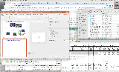
Very Different Situation Today
Powerful system
Huge memory
Huge disk
Single user

Slide 25
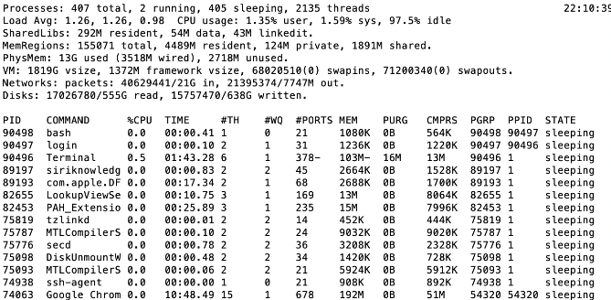
A Picture on one machine
Memory stays about 75% used, 25% for dynamics
A lot of it is shared 1.9 GB

Slide 26
Many Uses of Virtual Memory and “Demand Paging” …
Extend the stack
Allocate a page and zero it
Extend the heap (sbrk of old, today mmap)
Process Fork
Create a copy of the page table
Entries refer to parent pages – NO-WRITE
Shared read-only pages remain shared
Copy page on write
Exec
Only bring in parts of the binary in active use
Do this on demand
MMAP to explicitly share region (or to access a file as RAM)

Slide 27
Classic: Loading an executable into memory
disk (huge)
memory
info
data
code
exe
.exe
lives on disk in the file system
contains contents of code & data segments, relocation entries and symbols
OS loads it into memory, initializes registers (and initial stack pointer)
program sets up stack and heap upon initialization: crt0 (C runtime init)

Slide 28
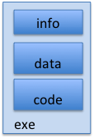
Create Virtual Address Space of the Process
disk (huge)
process VAS
memory
kernel
user page
frames
stack
sbrk
user pagetable
heap
data
kernel code & data
code
Utilized pages in the VAS are backed by a page block on disk
Called the backing store or swap file
Typically in an optimized block store, but can think of it like a file

Slide 29
Create Virtual Address Space of the Process
disk (huge, TB)
process VAS (GBs)
memory
kernel
stack
user page
frames
stack
heap
heap
user pagetable
data
data
code
kernel code & data
code
User Page table maps entire VAS
All the utilized regions are backed on disk
swapped into and out of memory as needed
For every process

Slide 30
Create Virtual Address Space of the Process
VAS
[per process]
disk (huge, TB)
PT
memory
kernel
stack
user page
frames
stack
heap
heap
user pagetable
data
data
code
kernel code & data
code
User Page table maps entire VAS
Resident pages to the frame in memory they occupy
The portion of it that the HW needs to access must be resident in memory

Slide 31
Provide Backing Store for VAS
VAS
[per process]
disk (huge, TB)
memory
kernel
stack
user page
frames
stack
heap
heap
user pagetable
data
data
code
kernel code & data
code
User Page table maps entire VAS
Resident pages mapped to memory frames
For all other pages, OS must record where to find them on disk
Many ways to do this, but might use remaining bits of PTE when P=0

Slide 32
What Data Structure Maps Non-Resident Pages to Disk?
FindBlock(PID, page#) → disk_block
Some OSs utilize spare space in PTE for paged blocks
Like the PT, but purely software
Where to store it?
In memory – can be compact representation if swap storage is contiguous on disk
Could use hash table (like Inverted PT)
Usually want backing store for resident pages too
May map code segment directly to on-disk image
Saves a copy of code to swap file
May share code segment with multiple instances of the program

Slide 33
Provide Backing Store for VAS
disk (huge, TB)
VAS 1
PT 1
memory
kernel
stack
stack
stack
heap
user page
frames
heap
heap
data
VAS 2
PT 2
data
code
user pagetable
data
kernel
code
stack
kernel code & data
heap
data
code

Slide 34
On page Fault …
disk (huge, TB)
VAS 1
PT 1
memory
kernel
stack
stack
stack
heap
user page
frames
heap
heap
data
VAS 2
PT 2
data
code
user pagetable
data
kernel
code
stack
kernel code
& data
heap
data
active process & PT
code

Slide 35
On page Fault … find & start load
disk (huge, TB)
VAS 1
PT 1
memory
kernel
stack
stack
stack
heap
user page
frames
heap
heap
data
VAS 2
PT 2
data
code
user pagetable
data
kernel
code
stack
kernel code & data
heap
data
active process & PT
code

Slide 36
On page Fault … schedule other P or T
disk (huge, TB)
VAS 1
PT 1
memory
kernel
stack
stack
stack
heap
user page
frames
heap
heap
data
VAS 2
PT 2
data
code
user pagetable
data
kernel
code
stack
kernel code & data
heap
data
active process & PT
code

Slide 37
On page Fault … update PTE
disk (huge, TB)
VAS 1
PT 1
memory
kernel
stack
stack
stack
heap
user page
frames
heap
heap
data
VAS 2
PT 2
data
code
user pagetable
data
kernel
code
stack
kernel code & data
heap
data
active process & PT
code

Slide 38
Eventually reschedule faulting thread
disk (huge, TB)
VAS 1
PT 1
memory
kernel
stack
stack
stack
heap
user page
frames
heap
heap
data
VAS 2
PT 2
data
code
user pagetable
data
kernel
code
stack
kernel code & data
heap
data
active process & PT
code

Slide 39
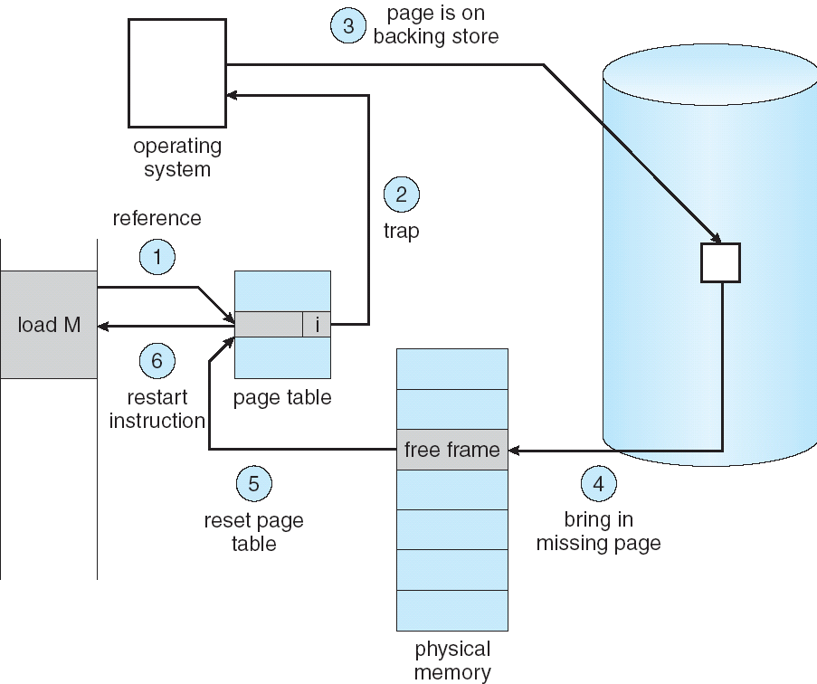
Summary: Steps in Handling a Page Fault

Slide 40
Some questions we need to answer!
During a page fault, where does the OS get a free frame?
Keeps a free list
Unix runs a “reaper” if memory gets too full
Schedule dirty pages to be written back on disk
Zero (clean) pages which haven’t been accessed in a while
As a last resort, evict a dirty page first
How can we organize these mechanisms?
Work on the replacement policy
How many page frames/process?
Like thread scheduling, need to “schedule” memory resources:
Utilization? fairness? priority?
Allocation of disk paging bandwidth

Slide 41
Working Set Model
As a program executes it transitions through a sequence of “working sets” consisting of varying sized subsets of the address space
Address
Time

Slide 42
Cache Behavior under WS model
1
new working set fits
Hit Rate
0
Cache Size
Amortized by fraction of time the Working Set is active
Transitions from one WS to the next
Capacity, Conflict, Compulsory misses
Applicable to memory caches and pages. Others ?

Slide 43
Another model of Locality: Zipf
Likelihood of accessing item of rank r is α 1/rª
Although rare to access items below the top few, there are so many that it yields a “heavy tailed” distribution
Substantial value from even a tiny cache
Substantial misses from even a very large cache

Slide 44
Demand Paging Cost Model
Since Demand Paging like caching, can compute average access time! (“Effective Access Time”)
EAT = Hit Rate x Hit Time + Miss Rate x Miss Time
EAT = Hit Time + Miss Rate x Miss Penalty
Example:
Memory access time = 200 nanoseconds
Average page-fault service time = 8 milliseconds
Suppose p = Probability of miss, 1-p = Probably of hit
Then, we can compute EAT as follows:
EAT = 200ns + p x 8 ms
= 200ns + p x 8,000,000ns
If one access out of 1,000 causes a page fault, then EAT = 8.2 μs:
This is a slowdown by a factor of 40!
What if want slowdown by less than 10%?
EAT < 200ns x 1.1 ⇒ p < 2.5 x 10⁻⁶
This is about 1 page fault in 400,000!

Slide 45
What Factors Lead to Misses in Page Cache?
Compulsory Misses:
Pages that have never been paged into memory before
How might we remove these misses?
Prefetching: loading them into memory before needed
Need to predict future somehow! More later
Capacity Misses:
Not enough memory. Must somehow increase available memory size.
Can we do this?
One option: Increase amount of DRAM (not quick fix!)
Another option: If multiple processes in memory: adjust percentage of memory allocated to each one!
Conflict Misses:
Technically, conflict misses don’t exist in virtual memory, since it is a “fully-associative” cache
Policy Misses:
Caused when pages were in memory, but kicked out prematurely because of the replacement policy
How to fix? Better replacement policy

Slide 46
Page Replacement Policies
Why do we care about Replacement Policy?
Replacement is an issue with any cache
Particularly important with pages
The cost of being wrong is high: must go to disk
Must keep important pages in memory, not toss them out
FIFO (First In, First Out)
Throw out oldest page. Be fair – let every page live in memory for same amount of time.
Bad – throws out heavily used pages instead of infrequently used
RANDOM:
Pick random page for every replacement
Typical solution for TLB’s. Simple hardware
Pretty unpredictable – makes it hard to make real-time guarantees
MIN (Minimum):
Replace page that won’t be used for the longest time
Great (provably optimal), but can’t really know future…
But past is a good predictor of the future …

Slide 47
Replacement Policies (Con’t)
LRU (Least Recently Used):
Replace page that hasn’t been used for the longest time
Programs have locality, so if something not used for a while, unlikely to be used in the near future.
Seems like LRU should be a good approximation to MIN.
How to implement LRU? Use a list:
On each use, remove page from list and place at head
LRU page is at tail
Problems with this scheme for paging?
Need to know immediately when page used so that can change position in list…
Many instructions for each hardware access
In practice, people approximate LRU (more later)
Page 6
Page 7
Page 1
Page 2
Head
Tail (LRU)

Slide 48
Example: FIFO (strawman)
Suppose we have 3 page frames, 4 virtual pages, and following reference stream:
A B C A B D A D B C B
Consider FIFO Page replacement:
FIFO: 7 faults
When referencing D, replacing A is bad choice, since need A again right away
Ref:
Page:
A
B
C
A
B
D
A
D
B
C
B
1
A
D
C
2
B
A
3
C
B

Slide 49
Example: MIN / LRU
Suppose we have the same reference stream:
A B C A B D A D B C B
Consider MIN Page replacement:
MIN: 5 faults
Where will D be brought in? Look for page not referenced farthest in future
What will LRU do?
Same decisions as MIN here, but won’t always be true!
Ref:
Page:
A
B
C
A
B
D
A
D
B
C
B
1
A
C
2
B
3
C
D

Slide 50
Is LRU guaranteed to perform well?
Consider the following: A B C D A B C D A B C D
LRU Performs as follows (same as FIFO here):
Every reference is a page fault!
Fairly contrived example of working set of N+1 on N frames
Ref:
Page:
A
B
C
D
A
B
C
D
A
B
C
D
1
A
D
C
B
2
B
A
D
C
3
C
B
A
D

Slide 51
When will LRU perform badly?
Consider the following: A B C D A B C D A B C D
LRU Performs as follows (same as FIFO here):
Every reference is a page fault!
MIN Does much better:
Ref:
Page:
A
B
C
D
A
B
C
D
A
B
C
D
1
A
D
C
B
2
B
A
D
C
3
C
B
A
D
Ref:
Page:
A
B
C
D
A
B
C
D
A
B
C
D
1
A
B
2
B
C
3
C
D

Slide 52
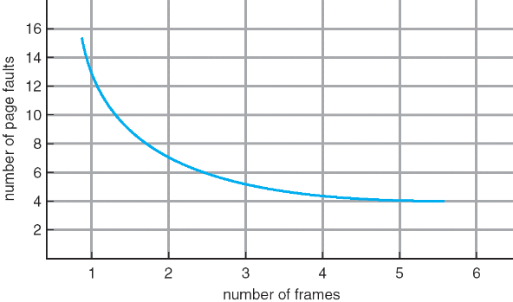
Graph of Page Faults Versus The Number of Frames
One desirable property: When you add memory the miss rate drops (stack property)
Does this always happen?
Seems like it should, right?
No: Bélády’s anomaly
Certain replacement algorithms (FIFO) don’t have this obvious property!

Slide 53
Adding Memory Doesn’t Always Help Fault Rate
Does adding memory reduce number of page faults?
Yes for LRU and MIN
Not necessarily for FIFO! (Called Bélády’s anomaly)
After adding memory:
With FIFO, contents can be completely different
In contrast, with LRU or MIN, contents of memory with X pages are a subset of contents with X+1 Page
Ref:
Page:
A
B
C
D
A
B
E
A
B
C
D
E
1
A
D
E
2
B
A
C
3
C
B
D
Ref:
Page:
A
B
C
D
A
B
E
A
B
C
D
E
1
A
E
D
2
B
A
E
3
C
B
4
D
C

Slide 54
Approximating LRU: Clock Algorithm
Set of all pages
in Memory
Single Clock Hand:
Advances only on page fault!
Check for pages not used recently
Mark pages as not used recently
Clock Algorithm: Arrange physical pages in circle with single clock hand
Approximate LRU (approximation to approximation to MIN)
Replace an old page, not the oldest page
Details:
Hardware “use” bit per physical page (called “accessed” in Intel architecture):
Hardware sets use bit on each reference
If use bit isn’t set, means not referenced in a long time
Some hardware sets use bit in the TLB; must be copied back to PTE when TLB entry gets replaced
On page fault:
Advance clock hand (not real time)
Check use bit: 1→ used recently; clear and leave alone 0→ selected candidate for replacement

Slide 55
Clock Algorithm: More details
Set of all pages
in Memory
Single Clock Hand
Will always find a page or loop forever?
Even if all use bits set, will eventually loop all the way around ⇒ FIFO
What if hand moving slowly?
Good sign or bad sign?
Not many page faults
or find page quickly
What if hand is moving quickly?
Lots of page faults and/or lots of reference bits set
One way to view clock algorithm:
Crude partitioning of pages into two groups: young and old
Why not partition into more than 2 groups?

Slide 56
N^{th} Chance version of Clock Algorithm
N^{th} chance algorithm: Give page N chances
OS keeps counter per page: # sweeps
On page fault, OS checks use bit:
1 → clear use and also clear counter (used in last sweep)
0 → increment counter; if count=N, replace page
Means that clock hand has to sweep by N times without page being used before page is replaced
How do we pick N?
Why pick large N? Better approximation to LRU
If N ~ 1K, really good approximation
Why pick small N? More efficient
Otherwise might have to look a long way to find free page
What about “modified” (or “dirty”) pages?
Takes extra overhead to replace a dirty page, so give dirty pages an extra chance before replacing?
Common approach:
Clean pages, use N=1
Dirty pages, use N=2 (and write back to disk when N=1)

Slide 57
Recall: Meaning of PTE bits
Which bits of a PTE entry are useful to us for the Clock Algorithm? Remember Intel PTE:
The “Present” bit (called “Valid” elsewhere):
P==0: Page is invalid and a reference will cause page fault
P==1: Page frame number is valid and MMU is allowed to proceed with translation
The “Writable” bit (could have opposite sense and be called “Read-only”):
W==0: Page is read-only and cannot be written.
W==1: Page can be written
The “Accessed” bit (called “Use” elsewhere):
A==0: Page has not been accessed (or used) since last time software set A→0
A==1: Page has been accessed (or used) since last time software set A→0
The “Dirty” bit (called “Modified” elsewhere):
D==0: Page has not been modified (written) since PTE was loaded
D==1: Page has changed since PTE was loaded
PTE:
Page Frame Number
(Physical Page Number)
Free
(OS)
0
PS
D
A
PCD
PWT
U
W
P
31-12
11-9
8
7
6
5
4
3
2
1
0

Slide 58
Clock Algorithms Variations
Do we really need hardware-supported “modified” bit?
No. Can emulate it using read-only bit
Need software DB of which pages are allowed to be written (needed this anyway)
We will tell MMU that pages have more restricted permissions than the actually do to force page faults (and allow us notice when page is written)
Algorithm (Clock-Emulated-M):
Initially, mark all pages as read-only (W→0), even writable data pages. Further, clear all software versions of the “modified” bit → 0 (page not dirty)
Writes will cause a page fault. Assuming write is allowed, OS sets software “modified” bit → 1, and marks page as writable (W→1).
Whenever page written back to disk, clear “modified” bit → 0, mark read-only

Slide 59
Clock Algorithms Variations (continued)
Do we really need a hardware-supported “use” bit?
No. Can emulate it similar to above (e.g. for read operation)
Kernel keeps a “use” bit and “modified” bit for each page
Algorithm (Clock-Emulated-Use-and-M):
Mark all pages as invalid, even if in memory. Clear emulated “use” bits → 0 and “modified” bits → 0 for all pages (not used, not dirty)
Read or write to invalid page traps to OS to tell use page has been used
OS sets “use” bit → 1 in software to indicate that page has been “used”. Further: 1) If read, mark page as read-only, W→0 (will catch future writes) 2) If write (and write allowed), set “modified” bit → 1, mark page as writable (W→1)
When clock hand passes, reset emulated “use” bit → 0 and mark page as invalid again
Note that “modified” bit left alone until page written back to disk
Remember, however, clock is just an approximation of LRU!
Can we do a better approximation, given that we have to take page faults on some reads and writes to collect use information?
Need to identify an old page, not oldest page!
Answer: second chance list

Slide 60
Second-Chance List Algorithm (VAX/VMS)
LRU victim
Directly
Mapped Pages
Marked: RW
List: FIFO
Overflow
Second
Chance List
Marked: Invalid
List: LRU
Access
Page-in
From disk
New
Active Pages
New
SC Victims
Split memory in two: Active list (RW), SC list (Invalid)
Access pages in Active list at full speed
Otherwise, Page Fault
Always move overflow page from end of Active list to front of Second-chance list (SC) and mark invalid
Desired Page On SC List: move to front of Active list, mark RW
Not on SC list: page in to front of Active list, mark RW; page out LRU victim at end of SC list

Slide 61
Second-Chance List Algorithm (continued)
How many pages for second chance list?
If 0 ⇒ FIFO
If all ⇒ LRU, but page fault on every page reference
Pick intermediate value. Result is:
Pro: Few disk accesses (page only goes to disk if unused for a long time)
Con: Increased overhead trapping to OS (software / hardware tradeoff)
With page translation, we can adapt to any kind of access the program makes
Later, we will show how to use page translation / protection to share memory between threads on widely separated machines
History: The VAX architecture did not include a “use” bit. Why did that omission happen???
Strecker (architect) asked OS people, they said they didn’t need it, so didn’t implement it
He later got blamed, but VAX did OK anyway

Slide 62
Summary
Replacement policies
FIFO: Place pages on queue, replace page at end
MIN: Replace page that will be used farthest in future
LRU: Replace page used farthest in past
Working Set:
Set of pages touched by a process recently
Point of Replacement algorithms is to try to keep working set in memory
Clock Algorithm: Approximation to LRU
Arrange all pages in circular list
Sweep through them, marking as not “in use”
If page not “in use” for one pass, than can replace
Nth-chance clock algorithm: Another approximate LRU
Give pages multiple passes of clock hand before replacing
Second-Chance List algorithm: Yet another approximate LRU
Divide pages into two groups, one of which is truly LRU and managed on page faults.

